Slide 1
SDSU ARPE &
Interwork Institute
The year in review
December 12, 2024

Slide 2
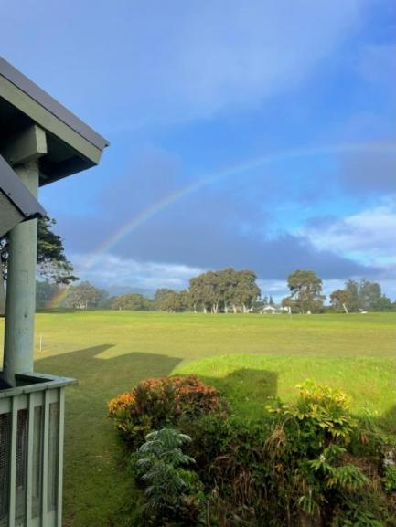
It’s been a year – with all the highs and lows

Slide 3
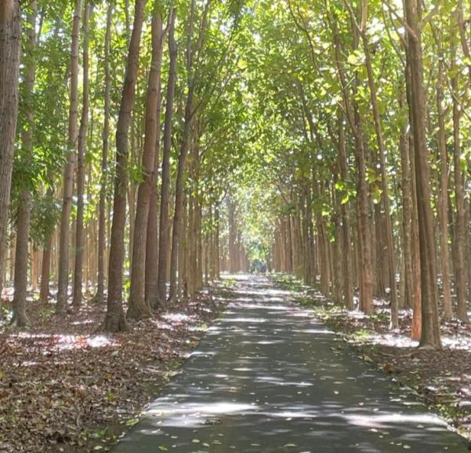
We came together to hold each other up and to continue to honor the memory of Fred.

Slide 4


On with the accomplishments . . .
$226 million total
FY 2023-24
Annual Awards Listing

Slide 5


Of the total $226 million:
College of Education total: $30,107,190
ARPE/Interwork $13,946,906
COE
Annual reports available: https://foundation.sdsu.edu/communications_publications.html

Slide 6
Thanks to the efforts of the Principal Investigators!
Meera Adya
Mary Baker-Ericzén
Chuck Degeneffe
Eric Felix
Mari Guillermo
Frank Harris III
Felisha Herrera Villareal
Toni Saia
Caren Sax including funds for EFRC & CSA*
Mark Tucker
Marissa Vasquez
*With special thanks to
Ian Pumpian, co-PI for CSA projects

Slide 7
Who each relied on the expertise & experience of those whose don’t hold the PI title, but write proposals & reports, direct/coordinate projects & services, provide fiscal and administrative support, & make the technology work:
John Summerfruit, Kathy Fleming, & Allie Rosenbloom
Minah Oh & the CDL Team
Chaz Compton
Drew Karhan, Chip Kenney, Amber McConnell, Patricia Henke, & Esmeralda Jones
Allison Flanagan & the NRLI team
Joyce Clark & Lupe Rojas-Sanchez & the EFRC team
Josh Belfy & Mary Ellen Sousa & the CSA team
Theresa Lally

Slide 8
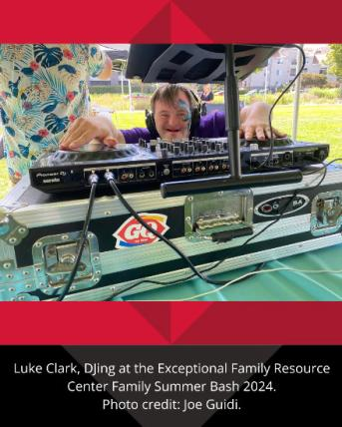
Here are some highlights:

Slide 9
Administration, Rehabilitation, & Postsecondary Education (ARPE)
Degree Programs
Certificate Programs
Ed.D. in Community College Leadership
B.S. and undergraduate minor in Leadership Studies
M.A. in Postsecondary Educational Leadership and Student Affairs (PELSA)
M.S. in Rehabilitation Counseling
Cognitive Disabilities
Co-Occurring Disorders
Psychiatric Rehabilitation
Rehabilitation Technology

Slide 10
ARPE updates
Dr. Degeneffe’s term as Department Chair will end on July 31st. A vote for a new chair will take place in the Spring 2025 semester.
The B.S. in Leadership Studies was approved by the CSU Chancellor's Office in September 2023. A total of 16 students declared the major in the 23-24 AY; the enrollment target for Fall 25 is 28 students.
Dr. Guillermo is revising the Certificate in Supported Employment and Transition. Admission of new certificate students is planned for the 25-26 AY.
The Rehabilitation Counseling Program will end accreditation by the Council for Accreditation of Counseling and Related Educational Programs at the end of the Fall 24 semester.
ARPE held its annual Advisory Committee meeting on May 2, 2024, with representatives from each of the Department’s degree programs.
ARPE is exploring the possibility of a name change to reflects its current degree and certificate programs

Slide 11
How ARPE & Interwork intersect for research, student support, professional development:
CDER (Global Campus) Master’s in Rehabilitation Counseling (Dr. Degeneffe and Ms. Thomas)
Community College Equity Assessment Lab (Drs. Harris III and Vasquez)
Community College Higher Ed Access Leadership Equity Scholarship (Dr. Felix)
Lunch and Learn Research Seminar Series (Dr. Degeneffe)
Rehabilitation Improvements in Services and Employment for Underserved Populations (Drs. Guillermo and Tucker)
Research and Equity Scholarship Institute on Student Trajectories in Education (Dr. Herrera Villarreal)
U.S. Department of Education Long-Term Training Grants (Drs. Degeneffe, Guillermo, Tucker, and Saia)

Slide 12
A few individual accomplishments:
Dr. Degeneffe named as a Fellow in the American Psychological Association
Dr. Herrera Villarreal named as a Fellow in the Hispanic Association of Colleges and Universities’ Leadership Academy
Dr. Vasquez elected as Chair of the American Association of Hispanics in Higher Education
Dr. Saia received the Judy Heumann Civil Leadership Award from the Indoor Sports Club
Dr. Baker-Ericzén was awarded the 2024 SDSU Outstanding Faculty Research, Scholarship and Creativity Award (RSCA) Award!

Slide 13
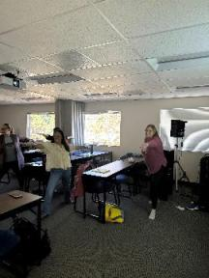
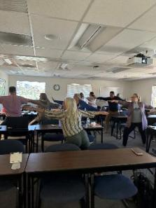
Exceptional Family Resource Center (EFRC)
https://efrconline.org

Slide 14



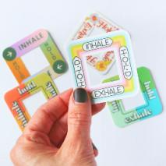

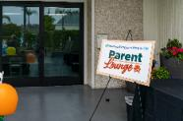

EFRC Self-Care Activities & Resources
JUST
BREATHE
CALM STRIPS
Early Start
Together

Slide 15
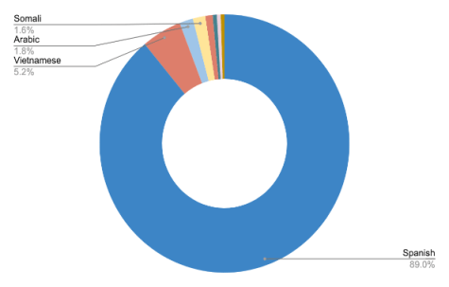
EFRC’s LANGUAGE ACCESS
PROGRAM
60 languages countywide –
35 most commonly spoken in San Diego & Imperial Counties
Improved Service Delivery
  Enhancing communication and satisfaction with public services.
Increased Community Trust
  Strengthening relationships between institutions and LEP communities.
Legal Compliance and Risk Reduction
  Avoiding potential lawsuits or penalties by adhering to language access regulations.

Slide 16

Connect with EFRC
Online Calendar
EFRC Events
Like / follow / subscribe:
https://www.facebook.com/Efrconline/
https://www.instagram.com/efrc_online/
https://www.youtube.com/@ExceptionalFamilyResourceCntr.
EFRConline
Notes:
Joe

Slide 17
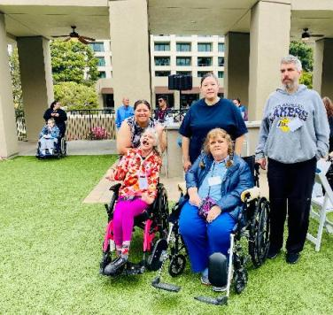
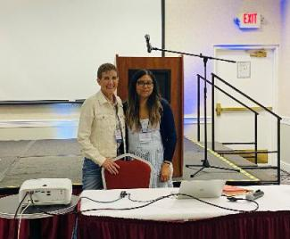
Creative Support Alternatives (CSA)
http://www.creativesupport.org/

Slide 18
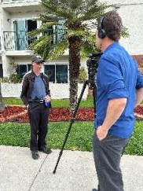
What’s new with CSA:
Sharing info: Supported Life Institute 2024, Josh & Justin at SDSU Credential program, Derly & Mary Ellen at CHOICES Institute/NoCA, Derly, Viri & Rissa at the People First conference
Supporting community: CSA acted as the fiscal sponsor and provided planning support to the self-advocate run San Diego People First Conference.
PR: Justin was featured on CBS News program “The Zevely Zone” with Jeff Zevely, Brenda began working at UCSD Hillcrest

Slide 19
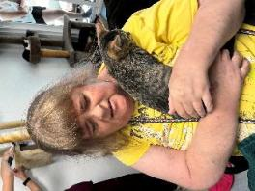
What’s new with CSA: (continued)
Creative Support Alternatives is accepting new referrals (if you know anyone in need of services or info.)
Leadership Team development thru expanded & continuing education opportunities and Leadership Retreats
Developed/maintained expertise with state and federal mandated service requirements and regulations
Provided a bonus and raise for direct support team members, with another raise anticipated in 2025
Autumn, volunteering at Friends of Cats

Slide 20
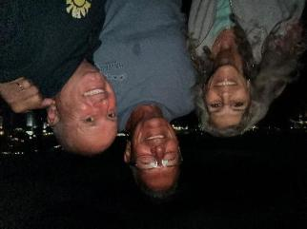
VRTAC-QM & VR-related projects
AKA Chaz & Team
https://www.vrtac-qm.org/

Slide 21
Vocational Rehabilitation Technical Assistance for Quality Management (VRTAC-QM)
Final year of 5-year grant - $3,344,560 per year
All targets achieved
24 intensive technical assistance agreements
All 78 VR agencies received at least targeted TA and training
More than 1,600 TA events
More than 12,500 VR staff received TA and training (not an unduplicated amount)

Slide 22
Comprehensive Statewide Needs Assessments in the Last Year
CNMI - $23,987
Florida General - $96,367
Florida Blind - $79,522
New Mexico General - $49,894
Oregon General - $76,751
Hawaii - $96,267
DC - $142,338
Plus:
Virginia Blind - $61,936 (in progress)
Virginia General - $77,971 (in progress)
And coming soon:
Delaware General and Blind
Colorado

Slide 23
Disability Innovation Fund (DIF) Grants
CNMI - Technology Partners Increasing Employment through Coordinated Services: Tech-PIECS – $9.1 million over five years - $350,000 per year for five years to Interwork
Subminimum Wage to Competitive Integrated Employment (SWTCIE) grants:
California: $13.8 million to DOR overall for five years. Between $740,000 to $850,000 per year for Interwork
New York: $14 million to NY VR. Average to Interwork of $770,000 per year for five years

Slide 24
Other DIF Grants
Pathways to Success Project (PSP)
Funded by the U.S. Department of Education, Rehabilitation Services Administration (RSA) to CA Dept. of Rehabilitation, Subcontract to Interwork
  5-year award: $1.2 Million to DOR/$600K to Interwork each year for 5 years
  Partner with the SARA and Portals LLC → MarketLinkVR.
  Conduct comprehensive program evaluation and provide technical assistance and training to support Career Pathways for individuals with disabilities through VR.
  Led by Esmeralda Jones, Meera Adya, Chip Kenney
SWTCIE projects
Each with Interwork as a subcontractor to Griffin-Hammis Associates:
  Virginia - $108,000 per year for four years
  Iowa - $30,000 per year for five years
  Florida - $50,000 per year for four years. [Not in place yet]

Slide 25
Focus on Transition & Employment
Equitable Transition Demonstration – New York
Center for Advancing Policy on Employment for Youth (CAPE-Youth)
Funded by the U.S. Department of Labor, Office of Disability Employment Policy (ODEP)
  5-year award for an RCT demonstration: $1.9 Million to SDSU
  Focus on multiply-marginalized youth population(s) by building upon PROMISE, SSI Youth Solutions, & Guideposts for Success Framework
  Partner with NYS Department of Labor, Adult Career and Continuing Education Services –ACCES (VR and Adult Ed), Office of Mental Health, and Youth Power
  Serving 1350 (675 in Intervention)
  Led by Drew Karhan and Amber McConnell
Funded by the U.S. Department of Labor, Office of Disability Employment Policy (ODEP)
  5-year award: $1.4 Million to SDSU
  Partner with the Council of State Governments, Cornell University, and the National Association of Workforce Development Professionals.
  Researches new and existing innovative policy and practice; develops strategic partnerships; shares best practices among key stakeholders; and assists states in changing policy and practice.
  Led by Drew Karhan, Amber McConnell, Patricia Henke, Mari Guillermo, and Mary Baker-Ericzén

Slide 26

Rehabilitation Improvements in
Services & Employment for Underserved Populations
Mari Guillermo & Mark tucker

Slide 27
GOAL: To improve services and outcomes for disabled individuals from underserved populations
Knowledge development activities
Training and TA to 10 State VR Agencies
Coordination & information dissemination

Slide 28
Launching in Year 2
National Survey
Project Website
Online Modules
Agreements with State VR Agencies

Slide 29
National Rehabilitation Leadership Institute (NRLI)
Allison Flanagan & Team

Slide 30
2024 NRLI cohort: 47 participants from 24 state VR agencies!
NRLI Issue Papers addressed: Rapid Engagement and Modernization of the VR program; Vocational Rehabilitation Branding; Pre-Employment Transition Services; Fiscal Management Strategies; VR services for Individuals with Mental Health. These critical issues within VR are shared with our Federal partners and Congressional leaders for national solutions.
The 2025 Cohort has received 43 applications representing 23 SVRAs
Plans in 2025: Enhancing our use of technology, i.e., electronic surveys, annual survey of all participants (over 450) for evaluation purposes, shared/dedicated web space for the cohort to communicate, share resources, and provide presentation material.
NRLI is enhancing their website to include a ”History of NRLI" page that will honor the legacy Fred created

Slide 31

Autism Research
Projects
Mary Baker-Ericzén, PhD
Reilly Macdonald Caldwell, MS
Amanda Ferrell, MA
Slomith Castellon, BS

Slide 32
Autism Search Projects
Autism Patient-report outcome measures toolkit
AI-based vehicle technology simulator with behavioral strategies
Virtual Interview Training for Transition Age Youth
Multi-site NIMH R01, 20 autistic adults as research team members
Measurement tools for high priority outcomes; following 870 (N=166 in SD)
Preparing next proposal to continue follow up for 5 years re: services, supports, outcomes
Multi-site NSF, SDSU & Vanderbilt Univ Dept of Engineering
65 drivers (autistic teens, adults), 25 completed
Combined AI-based driving simulator + cognitive behavioral intervention for driving curriculum
Multi-site NIMH R01, SDSU & Univ of Michigan
Goal to enroll 100 autistic TAY

Slide 33

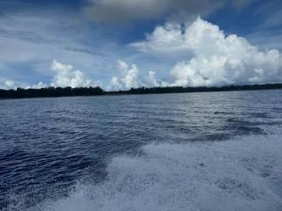
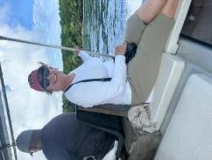
Center for Pacific Studies
Theresa Lally

Slide 34
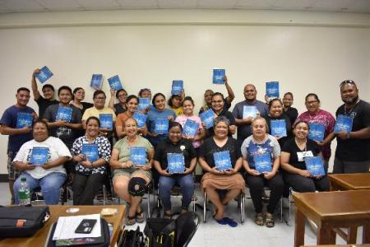
Current program: BA in Liberal Arts & Sciences, Major in Interdisciplinary Studies in 3 Departments, Jan. 2023 – May 2026
27 (of 30 who started) have completed 10 of 18 courses & are on track to graduate
Instructors have had very successful on-site visits for all classes, reporting great satisfaction with the student engagement.
Instructors visit local schools, businesses, and outer islands of Peleliu and Anguar.
Faculty are from: ARPE, STE, DLE, SPED, + those who teach upper division electives including Pacific Oceanography, Anthropology, Asian American Experience

Slide 35
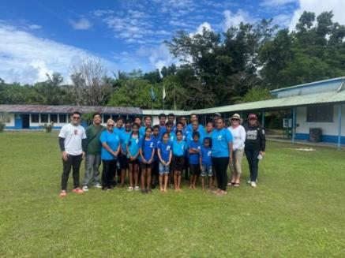
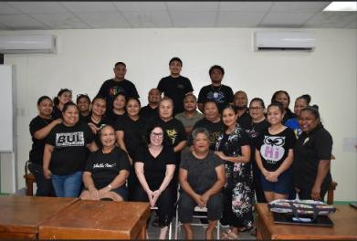
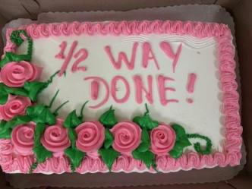
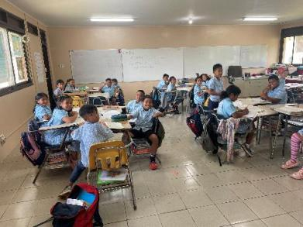
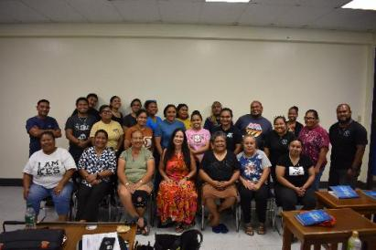
Palau BA Program Pictures

Slide 36
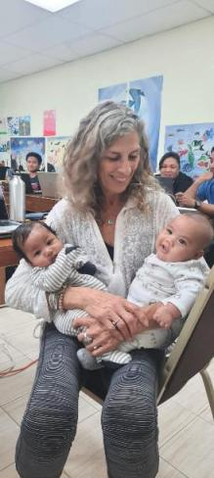
Palau BA Program
Overall, the program continues to provide courses that are specifically designed for the Palau population. The collaboration between Palau Community College and the Interwork Institute continues to grow.
Next program? Either a BA or MA, depending on the needs of the community.
Growing our next cohort!

Slide 37
And now a word from Minah on CDL

Slide 38


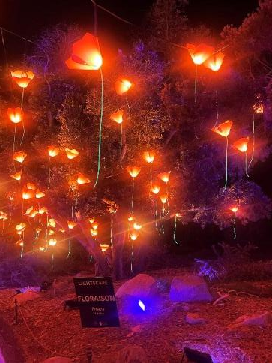
Wishing you all a happy, healthy,
& peaceful holiday season!

